Slide 1
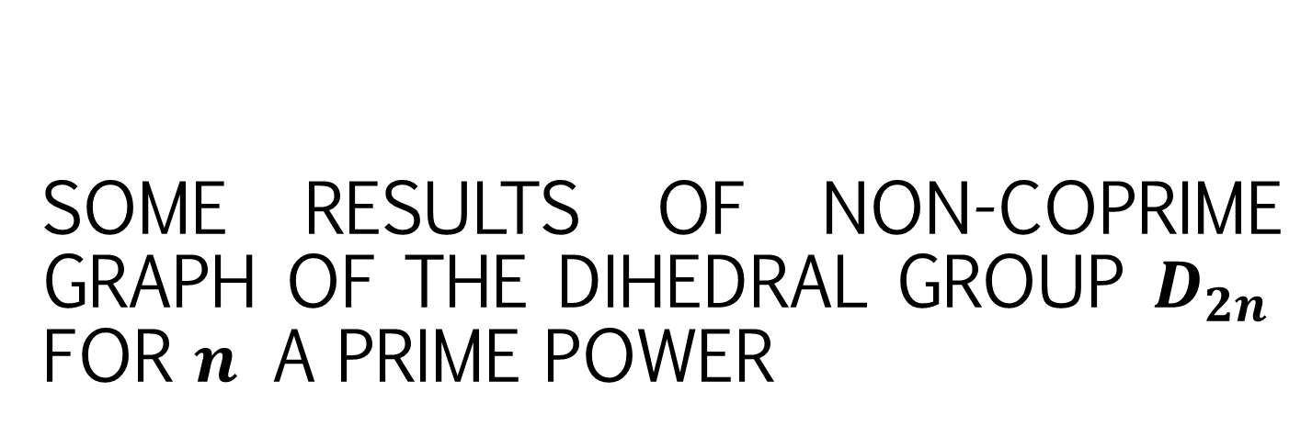
SOME RESULTS OF NON-COPRIME GRAPH OF THE DIHEDRAL GROUP $D_{2n}$ FOR $n$ A PRIME POWER
Wahyu Ulyafandhie Misuki, I Gede Adhitya Wisnu Wardhana, Ni Wayan Switrayni, Irwansyah

Slide 2
Introduction

Slide 3
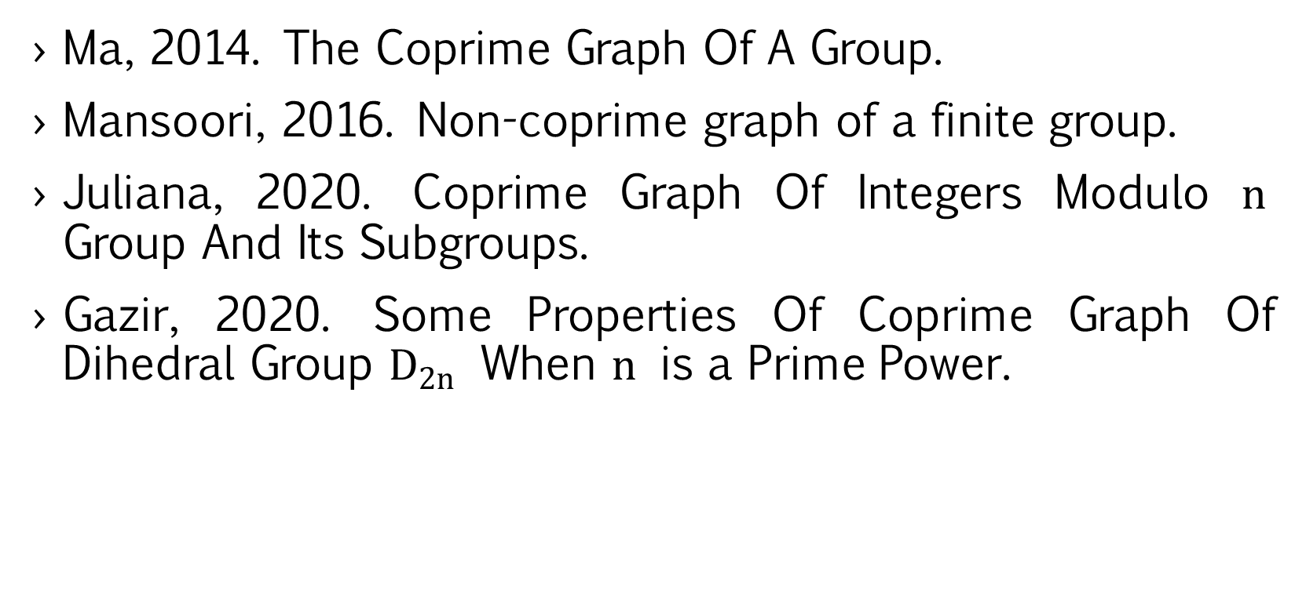
Ma, 2014. The Coprime Graph Of A Group.
Mansoori, 2016. Non-coprime graph of a finite group.
Juliana, 2020. Coprime Graph Of Integers Modulo $n$ Group And Its Subgroups.
Gazir, 2020. Some Properties Of Coprime Graph Of Dihedral Group $D_{2n}$ When $n$ is a Prime Power.

Slide 4

Definition 1
A graph is an ordered set $(V,E)$ comprising:
The set $V$ is non-empty set of vertices
The set $E$ is edge set of a pair vertices, $E⊆\{\left(v,w\right)∈V^{2}\}$

Slide 5

Definition 2
An undirected simple graph $G=(V,E)$ is called a complete graph if for every $x,y∈V$, then $\left(x,y\right)∈E$.

Slide 6
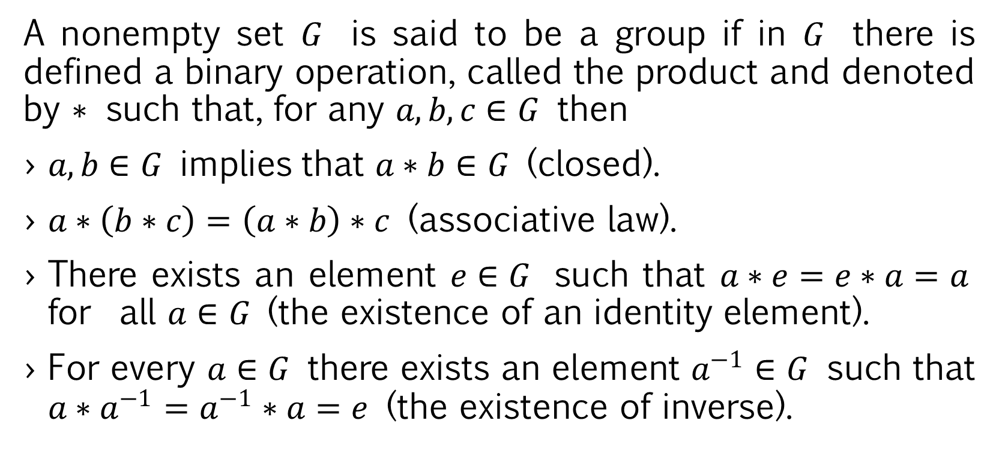
Definition 3
A nonempty set $G$ is said to be a group if in $G$ there is defined a binary operation, called the product and denoted by $∗$ such that, for any $a,b,c∈G$ then
$a,b∈G$ implies that $a∗b∈G$ (closed).
$a∗\left(b∗c\right)=\left(a∗b\right)∗c$ (associative law).
There exists an element $e∈G$ such that $a∗e=e∗a=a$ for all $a∈G$ (the existence of an identity element).
For every $a∈G$ there exists an element $a^{−1}∈G$ such that $a∗a^{−1}=a^{−1}∗a=e$ (the existence of inverse).

Slide 7

Theorem 1
Let $H$ be a non-empty subset of a group $G$. Subset $H$ is a subgroup of $G$ if and only if $ab^{−1}∈H$, for any $a,b∈H$.

Slide 8

Definition 4
Suppose $(G.∗)$ is any group. Let $a$ be any element of $G$. The smallest positive integer $m$ that satisfies $a^{m}=e$ is said as an order of $a$, and denoted as $\left|a\right|=m$

Slide 9

Definition 5
The dihedral group with order $2n$, denoted by $D_{2n}$ is the set:
$D_{2n}=\{e,a,a^{2},…, a^{n−1},b, ab,a^{2}b,…,a^{n−1}b|a^{n}=b^{2}=e, a^{−1}=bab\}$for $n≥ 3$.

Slide 10

Theorem 2
Let $D_{2n}=\{e,a,a^{2},…, a^{n−1},b, ab,a^{2}b,…,a^{n−1}b|a^{n}=b^{2}=e, a^{−1}=bab\}$, then$\left|b\right|=\left|ab\right|=…=\left|a^{n−1}b\right|=2$

Slide 11

Theorem 3
Let $D_{2n}$be the dihedral group with $n≥ 3$. If $S=\left\{e,a,a^{2},⋅⋅⋅,a^{n−1}\right\}⊆ D_{2n}$ then $S$ is a nontrivial subgroup of $D_{2n}$.

Slide 12

Theorem 4
Let $D_{2n}$be the dihedral group with $n≥ 3$. If $S=\left\{e,a^{i}b\right\}⊆ D_{2n}$ where $i=0,1,2,⋅⋅⋅,n−1$ then $S$ is a non-trivial subgroup of $D_{2n}$

Slide 13

Theorem 5
Let $D_{2n}$be the dihedral group with $n≥ 3$. If n is composite where $n = p_{1}p_{2}⋅⋅⋅ p_{k}$ then $S=\left\{e,a^{p_{i}},a^{2p_{i}}, ⋅⋅⋅ ,a^{n−p_{i}}\right\}⊆ D_{2n}$ is a non-trivial subgroup of $D_{2n}$.

Slide 14

Definition 6
Let $G$be a finite group. Non-coprime graph of group $G$, denoted by $\overline{Γ_{G}}$ is a graph with its vertices consist of $G−\left\{e\right\}$ and two different vertices $u$,$v$are said to be adjacent if$\left(\left|u \left|, \right|v\right|\right)≠ 1.$

Slide 15
Main Result

Slide 16

The non-coprime graph of $D_{2n}$ is a complete graph or can be partitioned into two complete graphs whenever $n$ is a prime power.

Slide 17
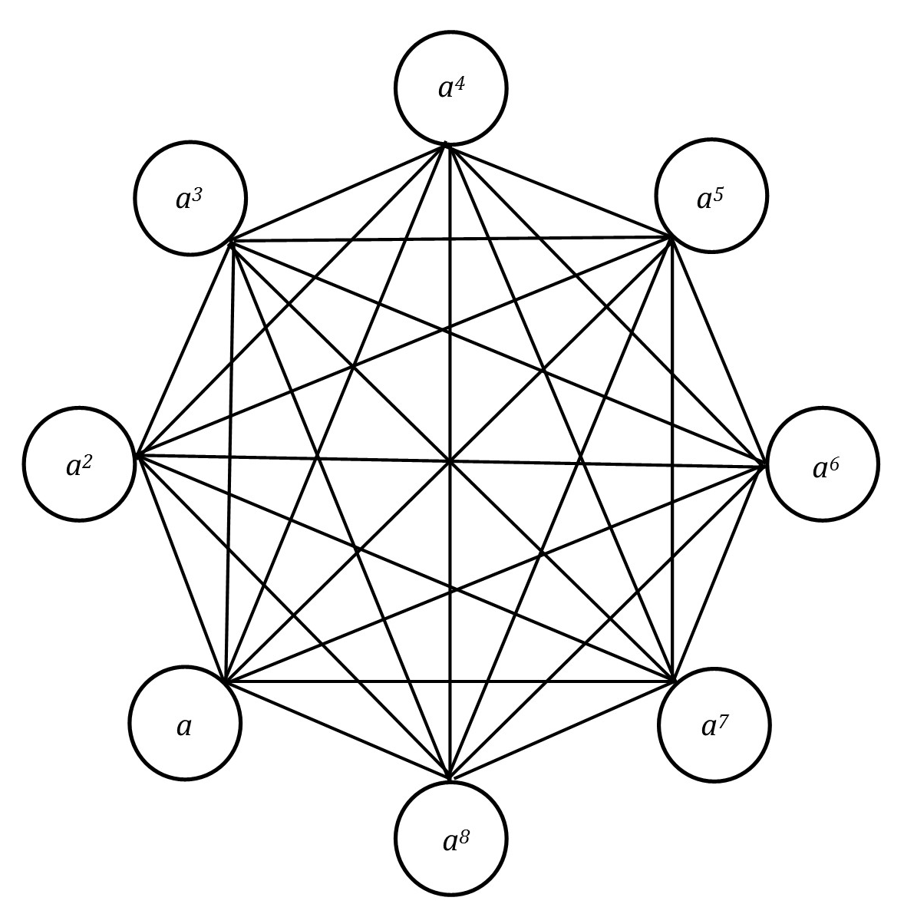
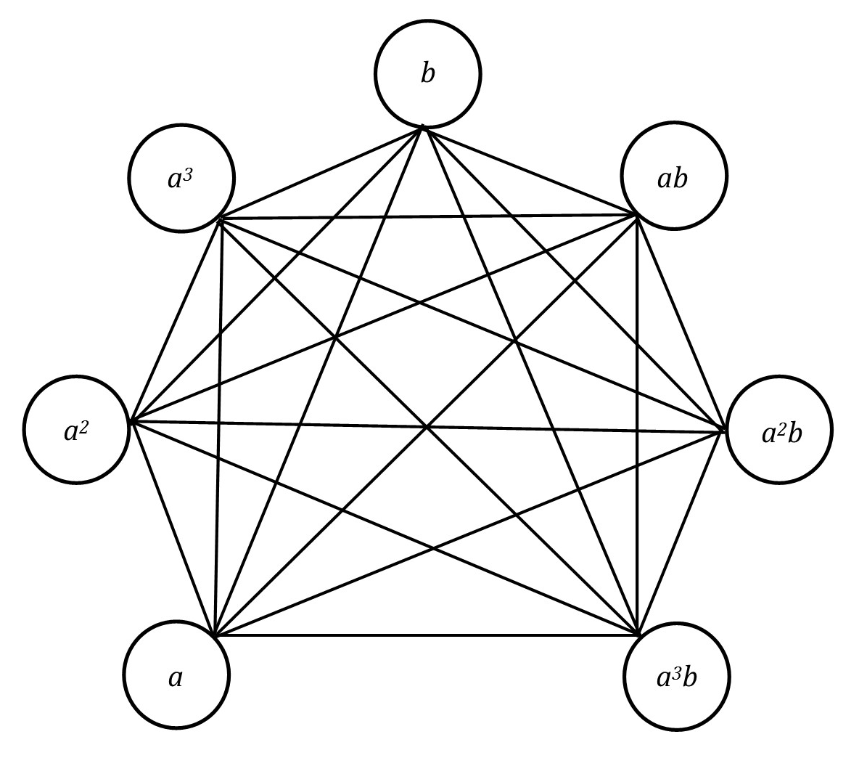
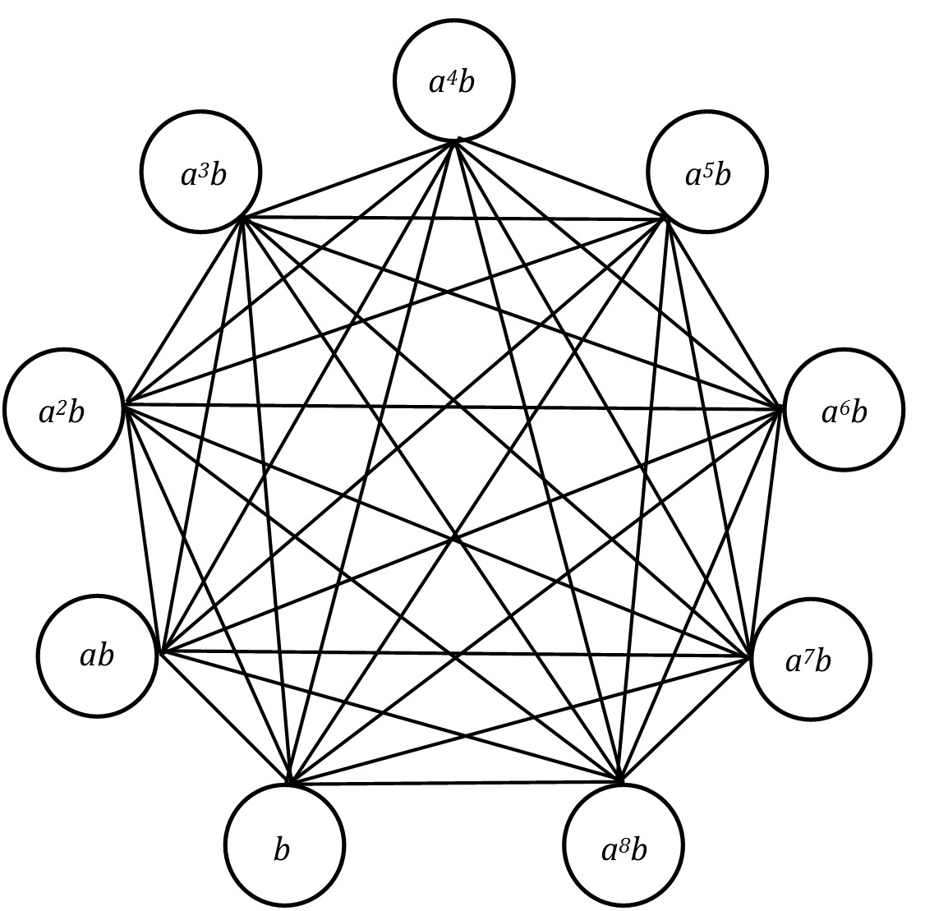


Example
Fig 1. Non-Coprime graph $D_{8}$
Fig 2. Non-Coprime graph $D_{18}$

Slide 18

Let $D_{2n}$be the dihedral group. If $n=2^{m}$ for some $m∈ℕ$, then $\overline{Γ_{D_{2n}}}$ is a complete graph.
Example :
$\overline{Γ_{D_{2.2 }}}$ , $\overline{Γ_{D_{2.2^{2}}}}$ and $\overline{Γ_{D_{2.2^{3}}}}$

Slide 19
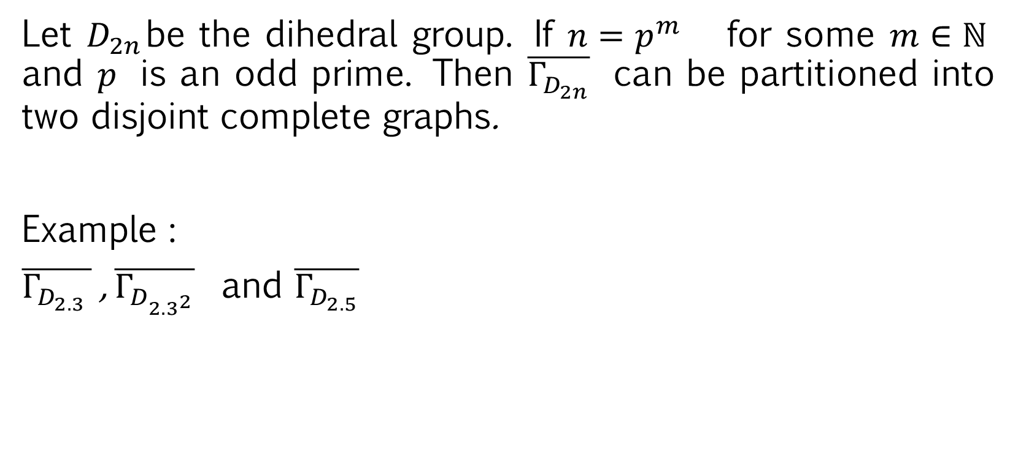
Let $D_{2n}$be the dihedral group. If $n=p^{m}$ for some $m∈ℕ$ and $p$ is an odd prime. Then $\overline{Γ_{D_{2n}}}$ can be partitioned into two disjoint complete graphs.
Example :
$\overline{Γ_{D_{2.3 }}}$ , $\overline{Γ_{D_{2.3^{2}}}}$ and $\overline{Γ_{D_{2.5}}}$

Slide 20
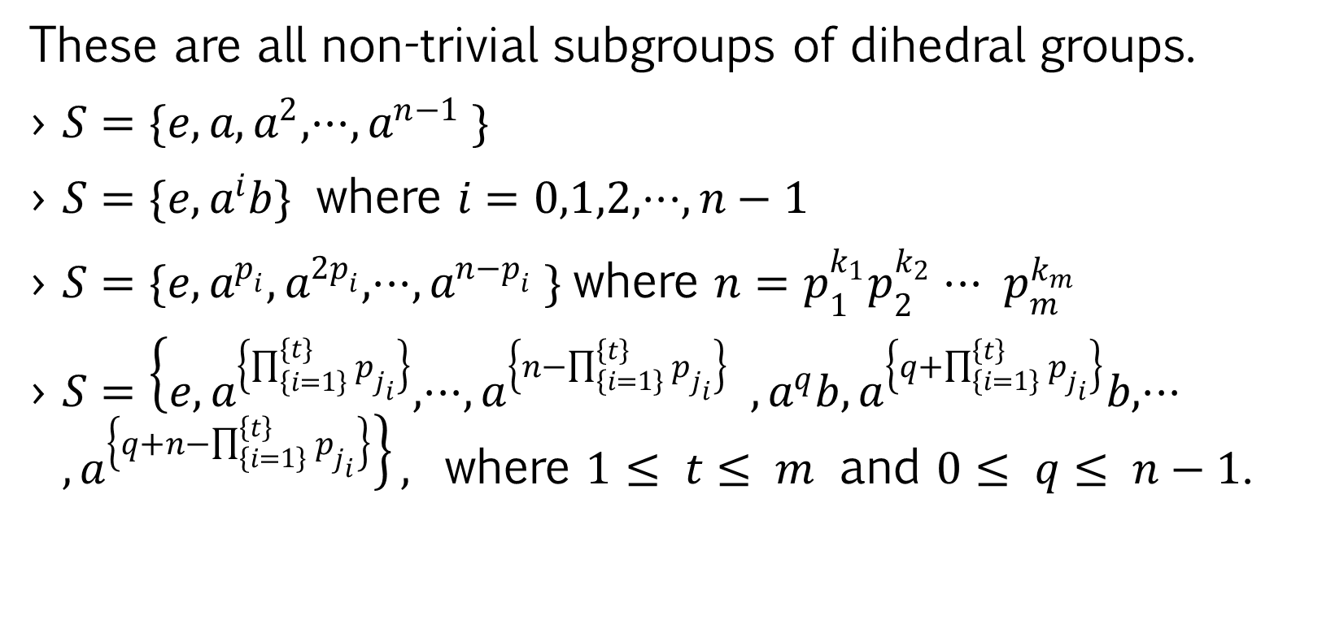
These are all non-trivial subgroups of dihedral groups.
$S=\{e,a,a^{2},⋅⋅⋅,a^{n−1} \}$
$S=\{e,a^{i}b\}$ where $i=0,1,2,⋅⋅⋅,n−1$
$S=\{e,a^{p_{i}},a^{2p_{i}},⋅⋅⋅,a^{n−p_{i}} \}$where $n=p_{1}^{k_{1}}p_{2}^{k_{2}}⋅⋅⋅ p_{m}^{k_{m}}$
$S=\left\{e,a^{\left\{\prod_{\left\{i=1\right\}}^{\{t\}}{p_{j_{i}}}\right\}},⋅⋅⋅,a^{\left\{n−\prod_{\left\{i=1\right\}}^{\left\{t\right\}}{p_{j_{i}}}\right\}} ,a^{q}b,a^{\left\{q+\prod_{\left\{i=1\right\}}^{\left\{t\right\}}{p_{j_{i}}}\right\}}b,⋅⋅⋅, a^{\left\{q+n−\prod_{\left\{i=1\right\}}^{\left\{t\right\}}{p_{j_{i}}}\right\}}\right\},$ where $1≤ t≤ m$ and $0≤ q≤ n−1$.

Slide 21

Let $S$ be a non trivial subgroup of dihedral group $D_{2n}$. If $n=p^{m}$ then the non-coprime graph of $S$ is a trivial graph or a complete graph or can be partitioned into two complete graphs.

Slide 22
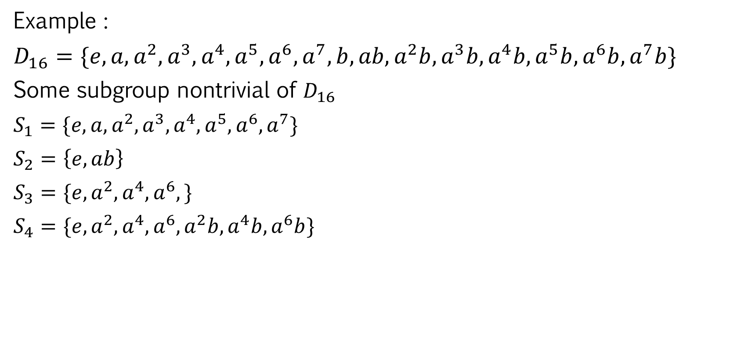
Example :
$D_{16}=\{e, a,a^{2},a^{3},a^{4},a^{5},a^{6},a^{7},b, ab,a^{2}b,a^{3}b,a^{4}b,a^{5}b,a^{6}b,a^{7}b\}$
Some subgroup nontrivial of $D_{16}$
$S_{1}=\{e,a,a^{2},a^{3},a^{4},a^{5},a^{6},a^{7}\}$
$S_{2}=\left\{e,ab\right\}$
$S_{3}=\{e,a^{2},a^{4},a^{6},\}$
$S_{4}=\{e,a^{2},a^{4},a^{6},a^{2}b,a^{4}b,a^{6}b\}$

Slide 23
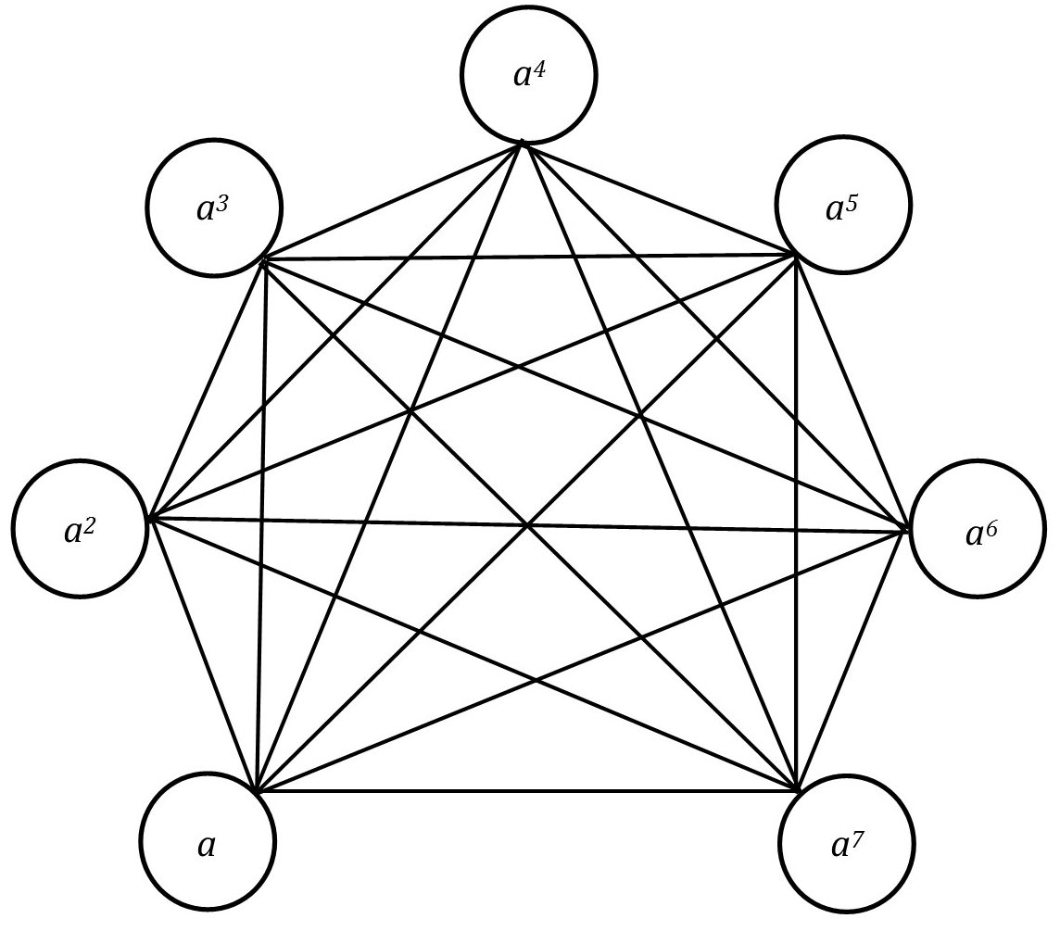

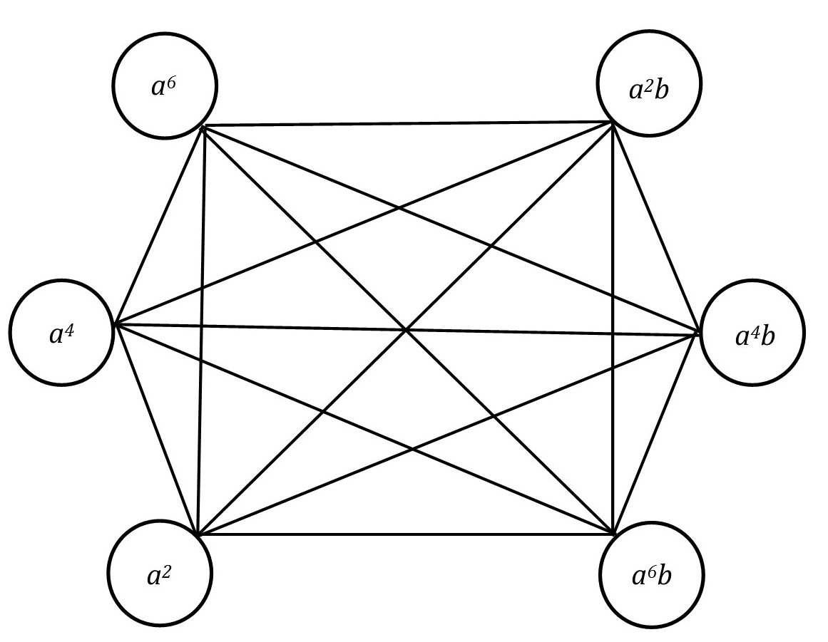
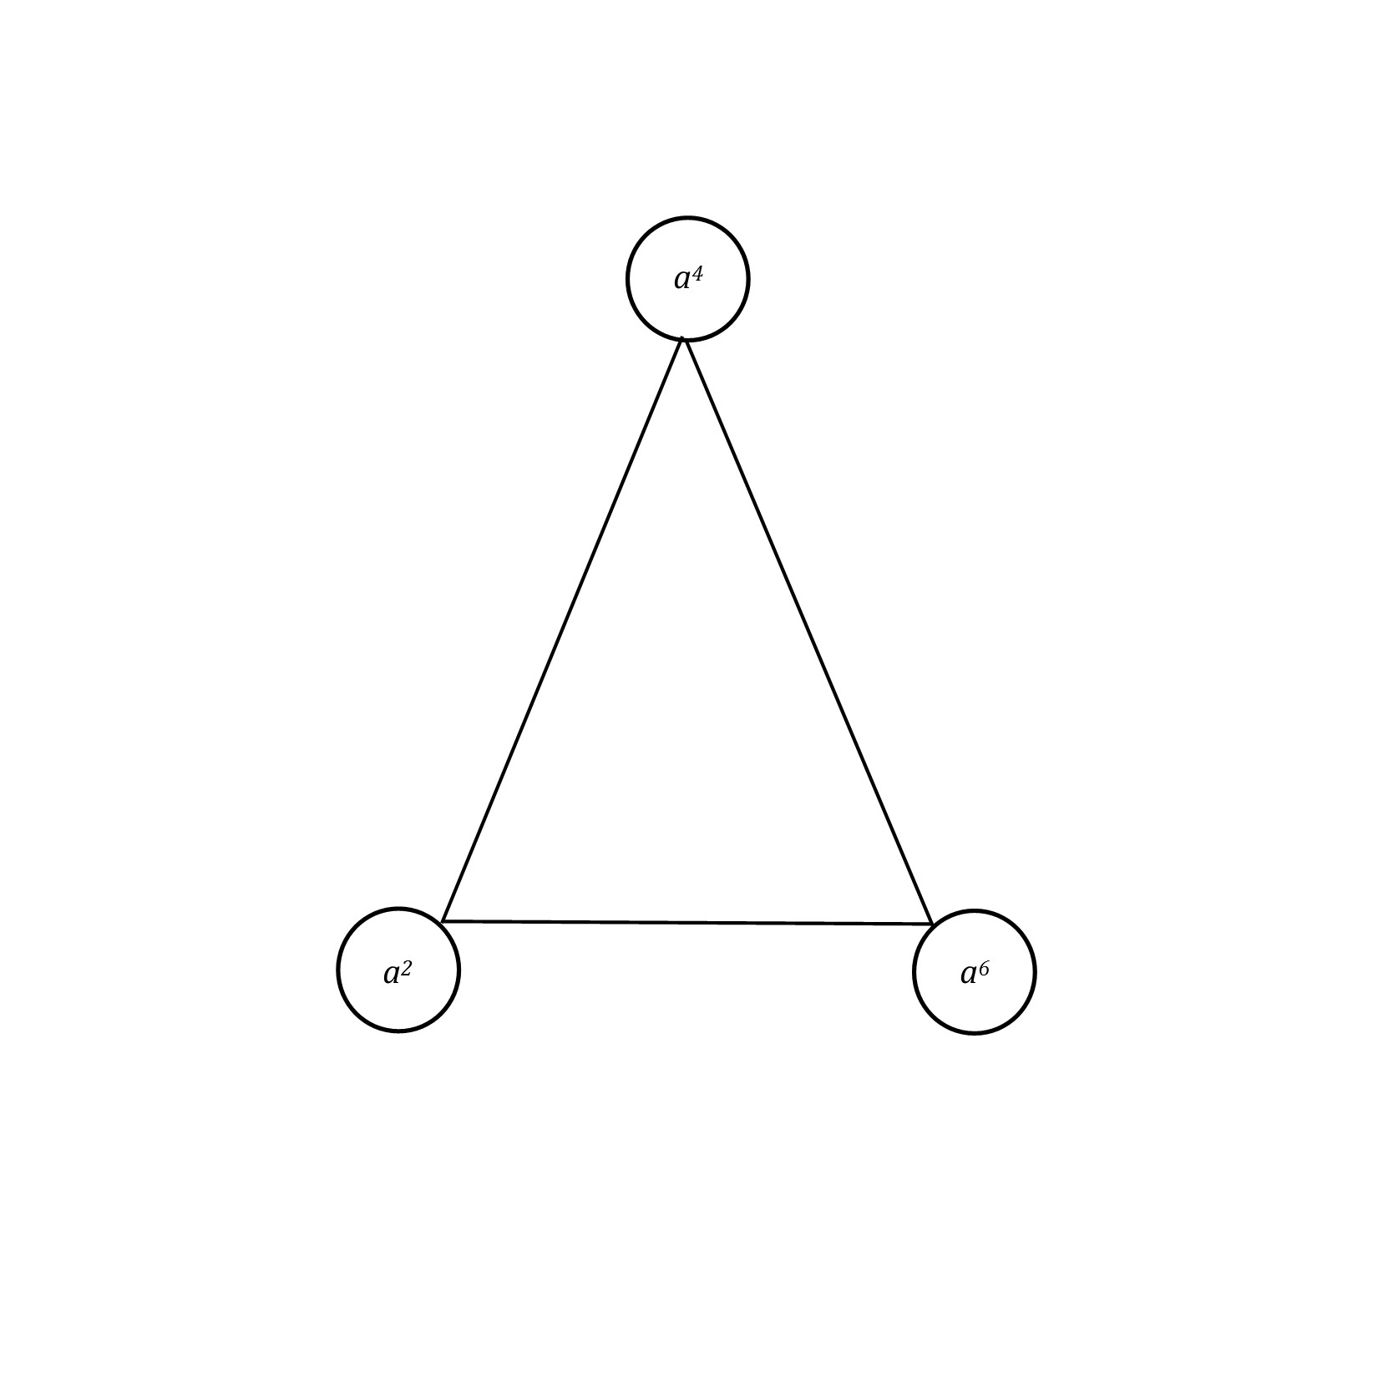




Fig 4. Non-Coprime graph $S_{2}$
Fig 3. Non-Coprime graph $S_{1}$
Fig 5. Non-Coprime graph $S_{3}$
Fig 6. Non-Coprime graph $S_{4}$

Slide 24
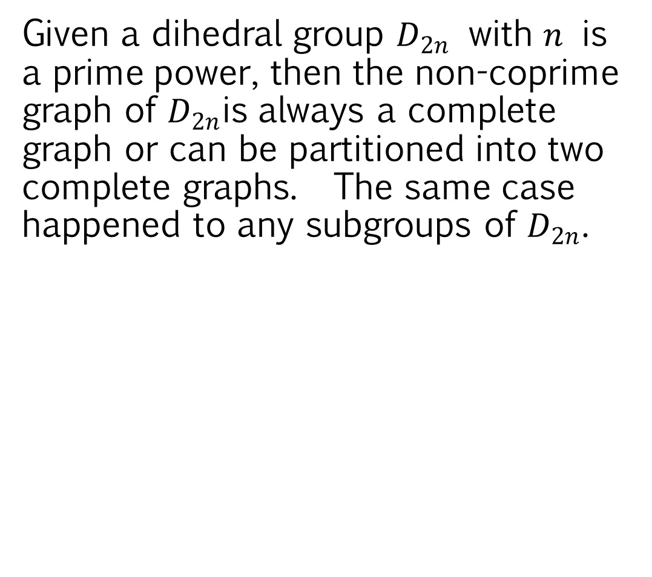
conclusions
Given a dihedral group $D_{2n}$ with $n$ is a prime power, then the non-coprime graph of $D_{2n}$is always a complete graph or can be partitioned into two complete graphs. The same case happened to any subgroups of $D_{2n}$.

Slide 25
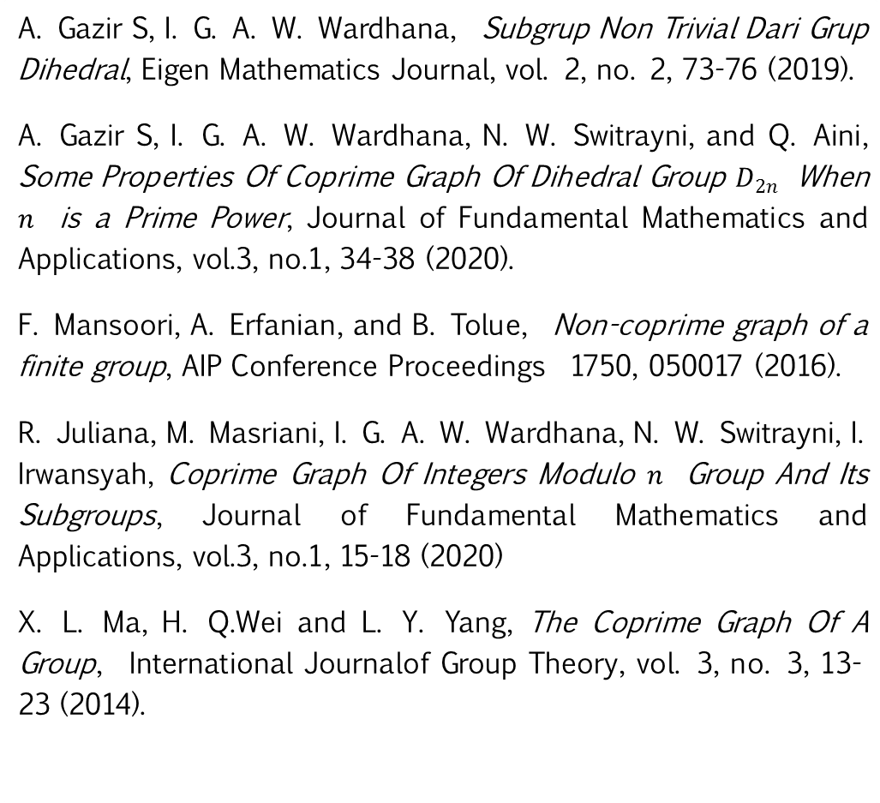
references
A. Gazir S, I. G. A. W. Wardhana, Subgrup Non Trivial Dari Grup Dihedral, Eigen Mathematics Journal, vol. 2, no. 2, 73-76 (2019).
A. Gazir S, I. G. A. W. Wardhana, N. W. Switrayni, and Q. Aini, Some Properties Of Coprime Graph Of Dihedral Group $D_{2n}$ When $n$ is a Prime Power, Journal of Fundamental Mathematics and Applications, vol.3, no.1, 34-38 (2020).
F. Mansoori, A. Erfanian, and B. Tolue, Non-coprime graph of a finite group, AIP Conference Proceedings 1750, 050017 (2016).
R. Juliana, M. Masriani, I. G. A. W. Wardhana, N. W. Switrayni, I. Irwansyah, Coprime Graph Of Integers Modulo $n$ Group And Its Subgroups, Journal of Fundamental Mathematics and Applications, vol.3, no.1, 15-18 (2020)
X. L. Ma, H. Q.Wei and L. Y. Yang, The Coprime Graph Of A Group, International Journalof Group Theory, vol. 3, no. 3, 13-23 (2014).

